Slide 1

Which had Worse maternal mortality rates than Texas and U.S. in 2015? https://www.cia.gov/library/publications/the-world-factbook/rankorder/2223rank.html

Slide 2



Maternal Mortality in Texas:
A story of ”Fake News” and Citizen Science
A copy of these slides will be available at www.curious-nurse.com or email phamilton@twu.edu
April 1, 2019
Dr. Patti Hamilton
Dr. Elizabeth Restrepo
Dr. Fuqin Liu
Ms. Katy Bezner
Cooke County
League of Women Voters
College of Health Sciences

Slide 3

Maternal Mortality is the Canary in the Coal Mine for a Country’s health and Health care
High maternal mortality ratios are markers of wider problems of
health status, gender inequalities, and health services for
men, women and children.

Slide 4
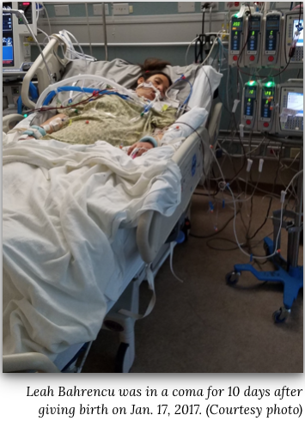
According to Dr. Manda Hall, associate commissioner for community health improvement at the Texas Department of State Health Services
“For every woman who dies, there are 50 to 100 women who suffer severe maternal morbidity, which is a severe complication of pregnancy…”

Slide 5
Pregnancy-related death
Indirect causes of death
Maternal Mortality
Direct causes of death
Pregnancy-associated death
Incidental causes of death
Maternal. death

Slide 6
DEFINING MATERNAL MORTALITY
TIMING OF DEATH
CAUSE OF DEATH
DURING PREGNANCY/BIRTH
PREGNANCY-RELATED CAUSES (HEMORRHAGE, ECLAMPSIA, INFECTION)
WITHIN 42 DAYS OF PREGNANCY/BIRTH
PREGNANCY - ASSOCIATED CAUSES (SUICIDE, HOMICIDE, DRUG OVERDOSE)
42-365 DAYS FOLLOWING PREGNANCY/BIRTH
INCIDENTAL CAUSES (CANCER, AUTO ACCIDENT)

Slide 7
BROADEST DEFINITION OF MATERNAL MORTALITY
The death of a woman while pregnant or within 1 year of the termination of pregnancy, regardless of cause of death or duration of pregnancy.

Slide 8
The Texas Task Force on Maternal Morbidity and Mortality used this more specific definition in its 2018 report.
“Pregnancy-related deaths occurring while pregnant or within 42 days postpartum are used in the calculation of maternal mortality rates (MMRs) …. “

Slide 9
What is the official Texas maternal mortality rate?
In 2016 the Texas Task Force reported 148 maternal mortalities within 42 days post partum in data from 2012.
That would be 38.7 deaths per 100,000 live births.

Slide 10
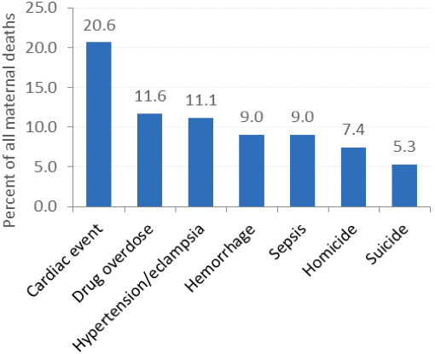
Finding #2 — Overdose by licit or illicit prescription drugs emerged as a leading cause of maternal death (from MMTF 2016 report)
Figure 2. Top 7 causes of maternal death in Texas in 2011-2012.
Here the Department of State Health Services is including Pregnancy- Associated along with Pregnancy - Related causes of maternal death.
These account for 74% of maternal deaths

Slide 11
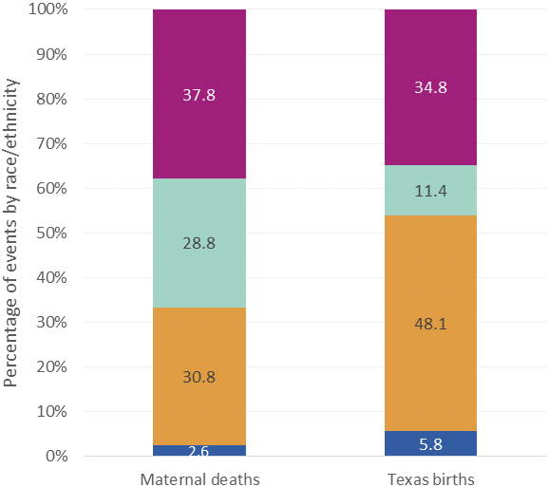
Finding #1 — Black women bear the greatest risk for maternal death
Figure 1. Percentage of Texas maternal deaths and births in 2011-2012 by mother’s race/ethnicity.
Source: CHS Birth and Death Files, 2011-2012
Prepared by: Office of Program Decision Support, FCHS, DSHS, 2016
White
Black
Hispanic
Other

Slide 12
Factors Associated with Maternal Mortality
Being Black;
Being 40 years old or older;
Receiving late or no prenatal care;
Having chronic health diseases such as pre-pregnancy obesity, diabetes;
Having hypertension;
Smoking during pregnancy;
Giving birth by cesarean section;
Being Unmarried;
Having a high school diploma or less;
Having no health insurance;
Being enrolled in Medicaid at time of delivery

Slide 13
None is Worse
All of these countries have lower maternal mortality rates than Texas and the U.S.

Slide 14
138 | UNITED STATES. 46th from the top | 14 | deaths per 100,000 births
139 | PUERTO RICO | 14
140 | QATAR | 13
141 | SAUDI ARABIA | 12
142 | KAZAKHSTAN | 12
143 | BOSNIA AND HERZEGOVINA | 11
144 | NEW ZEALAND | 11
145 | KOREA, SOUTH | 11
146 | BULGARIA | 11
147 | LITHUANIA | 10
148 | SINGAPORE | 10
149 | PORTUGAL | 10
150 | LUXEMBOURG | 10
151 | ESTONIA | 9
152 | LIBYA | 9
153 | UNITED KINGDOM | 9
154 | SLOVENIA | 9
155 | MALTA | 9
156 | IRELAND | 8
157 | MACEDONIA | 8
158 | CROATIA | 8
159 | FRANCE | 8
160 | BELGIUM | 7
161 | CANADA | 7
162 | NETHERLANDS | 7
163 | MONTENEGRO | 7
164 | CYPRUS | 7
165 | UNITED ARAB EMIRATES | 6
166 | AUSTRALIA | 6
167 | SLOVAKIA | 6
168 | GERMANY | 6
169 | DENMARK | 6
170 | ISRAEL | 5
171 | JAPAN | 5
172 | SWITZERLAND | 5
173 | SPAIN | 5
174 | NORWAY | 5
175 | AUSTRIA | 4
176 | BELARUS | 4
177 | SWEDEN | 4
178 | ITALY | 4
179 | KUWAIT | 4
180 | CZECHIA | 4
181 | FINLAND | 3
182 | POLAND | 3
183 | ICELAND | 3
184 | GREECE. Best | 3
Reported by the CIA
Based on 2015 data

Slide 15
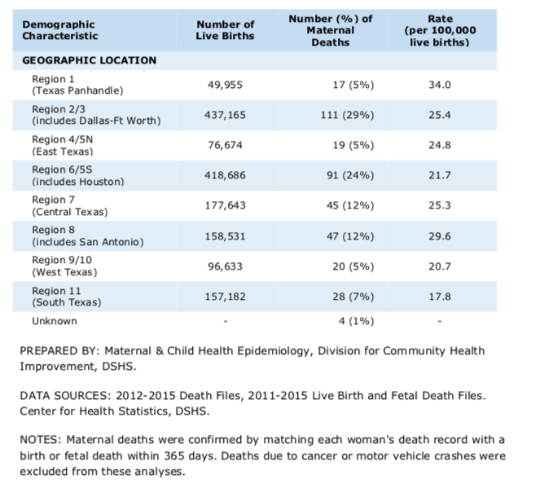
Which Texas Region has the worst maternal mortality rate?
Which Region has the best?

Slide 16
Worst
Why are these rates so much higher than previous CIA slide.
Best

Slide 17
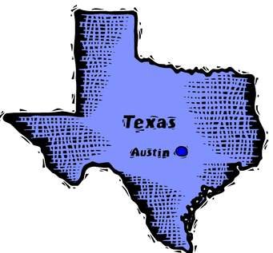
What is Texas doing about maternal mortalities ?

Slide 18
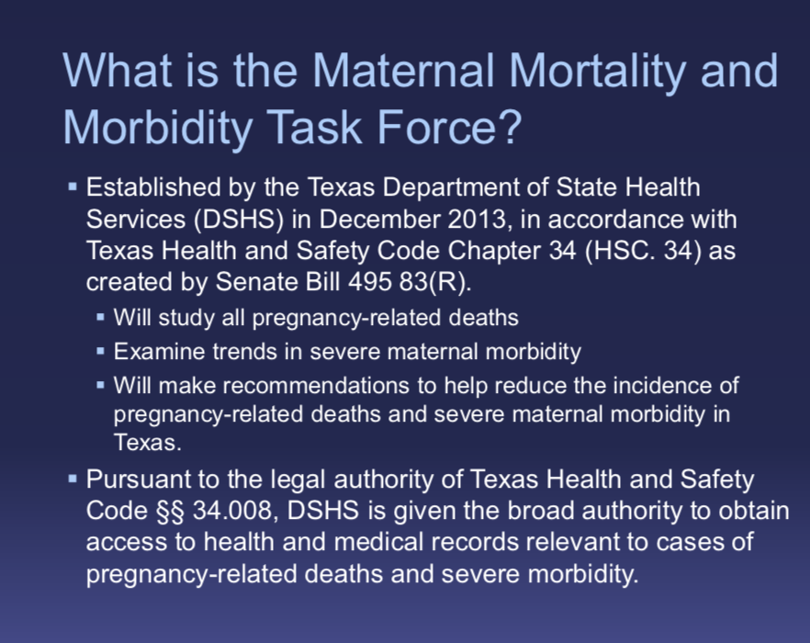

Slide 19
Texas AIM- prevent Maternal Death
The Department of State Health Services (DSHS) has teamed up with the national Alliance for Innovation on Maternal Health (AIM) and the Texas Hospital Association (THA) to create the TexasAIM initiative.
TexasAIM will help hospitals and clinics in Texas carry out maternal safety projects.

Slide 20


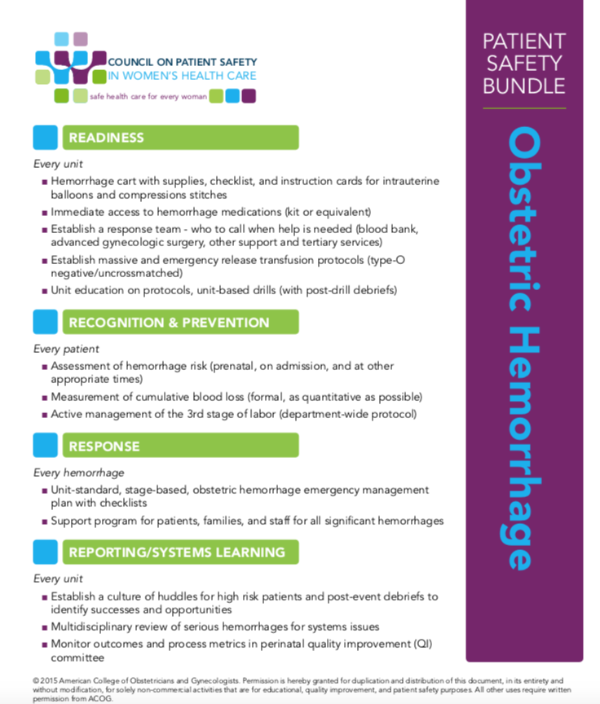
Evidence-based, best-practices for improving maternal care.
Hemorrhage cart with supplies, checklist, instruction cards on every unit….
Establish a response team….
Assessment of hemorrhage risk….
Stage-based obstetric hemorrhage response team…
Establish a culture of huddles for high-risk patients….
Participation is voluntary
Hospitals and birthing centers are currently being enrolled in TexasAim
Voluntary program
Hospitals and birthing centers being recruited now.

Slide 21
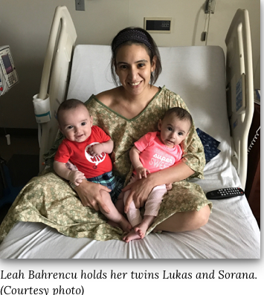
Evidence-based practices like these, saved the life of Leah Bahrencu

Slide 22
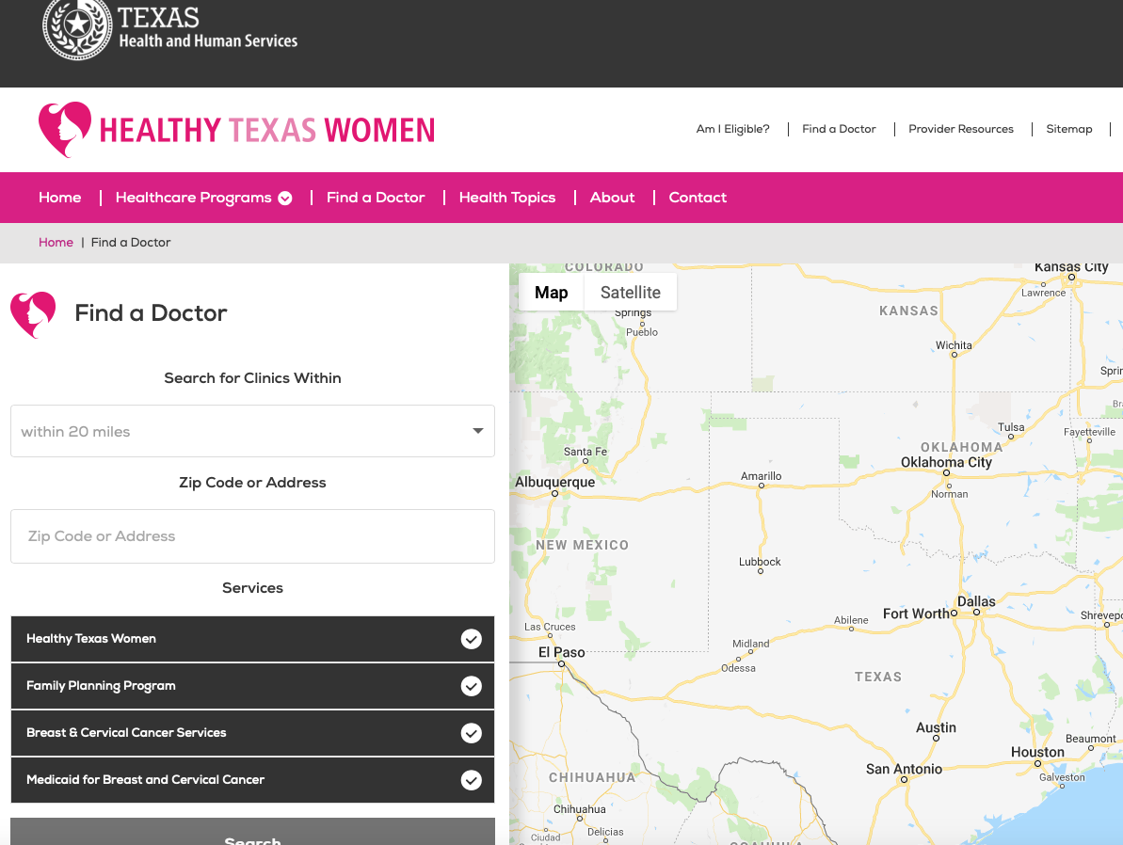
Established and Administered by the Texas Department of Health and Human Services
www.healthytexaswomen.org
Provide such services as:
Medicaid
WIC
Domestic Violence Help

Slide 23
Pause for Recap:
Maternal Mortality has more than one definition. The definition is critical because it defines the scope of the problem
Black women are at highest risk but a combination of risk factors can lead to death for any woman.
By most assessments, the United States is ranked much lower than the BEST.
Maternal mortality is a marker of serious public health issues.
Texas Department of State Health Services is taking steps to address maternal mortality.

Slide 24

Fake News about Maternal Mortality in Texas ?

Slide 25

News sources picked up this story across the U.S. in 2016

Slide 26
From the Washington Post

Slide 27
What’s wrong with the data?

Slide 28
In 2006 Texas adopted the US standard question on death certificates about pregnancy at time of death
At the time of death was the woman:
    Pregnant
    pregnant within 42 days
    43-365 days following pregnancy
    Not pregnant

Slide 29

“…. in any given data year, some states were using the U.S. standard question, others were using questions incompatible with the U.S. standard, and still others had no pregnancy question on their death certificates
Obstet Gynecol. 2016 September ; 128(3): 447–455. doi:10.1097/AOG.0000000000001556.

Slide 30

“Due in part to the difficulties in disentangling these effects, the United States has not published an official maternal mortality rate since 2007.”

Slide 31
The task force changed its method for calculating maternal mortality rate
Recall: In 2016 the Texas Task Force reported the
rate for 2012 as 148 maternal deaths within 42 days post partum (38.7 deaths per 100,000 live births).
They revised that 2012 rate in their 2018 report to the legislature.
Maternal Mortality and Morbidity Task Force Report 2018 p. 8

Slide 32
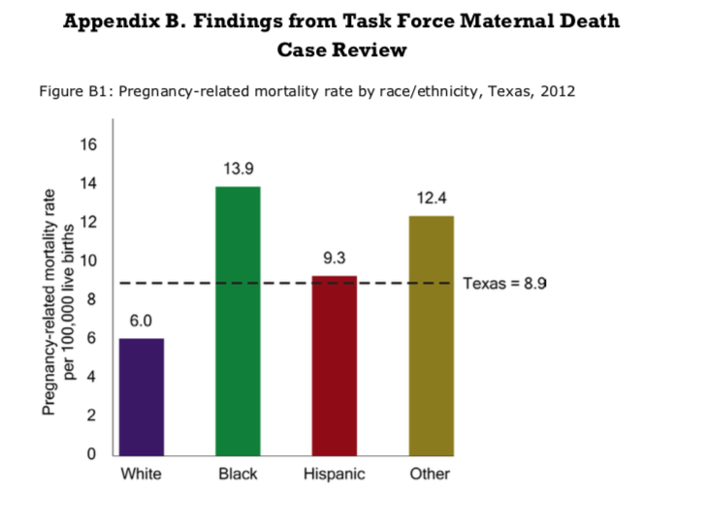
From 2018 MMTF report
p. B-1
Using the new enhanced method of calculating rate based on 34 cases
On par with Libya
On par with United Arab Emirates

Slide 33
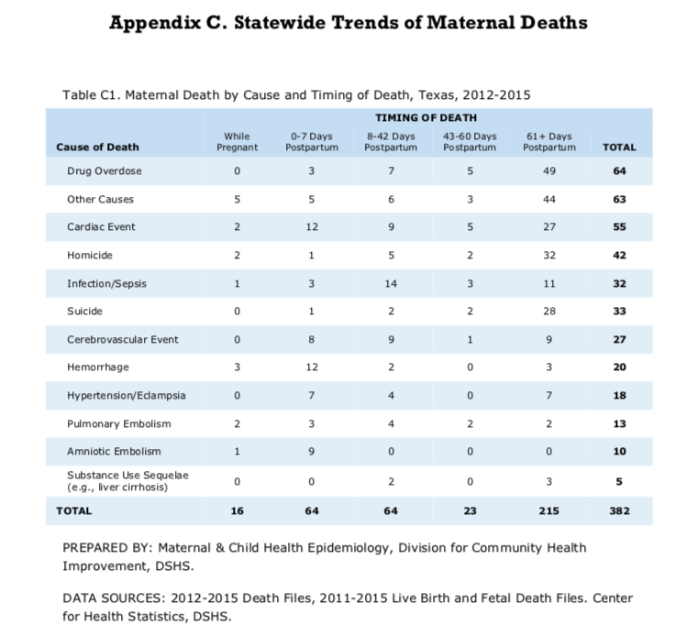
From the Texas Taskforce on Maternal Mortality’s 2018 Biennial Report
They removed all deaths beyond 42 days following pregnancy.
That would remove 68% of all the maternal deaths using the new “enhanced” method
To obtain the new rate they removed
Pregnancy-associated Deaths

Slide 34

Why would the Task Force’s new “enhanced” method (rate=8.9 rather than 38.7) omit maternal deaths more than 42 days following pregnancy and deaths from pregnancy-associated causes?
Was it a ruse
to make Texas look better?

Slide 35

Remember the old joke about the drunk looking for his keys?
The police officer asked where he lost them.

Slide 36


WHERE IS IT EASIEST TO FIND INFORMATION ABOUT
MATERNAL MORTALITY?
Hospital/ Clinic Records and Mother’s Death Certificate

Slide 37

Pregnancy-Associated Homicide Deaths in Texas 2013-2016
Pregnancy question filled out on only 271
death certificates
779 (74% of 1050) of homicide death records had no information on pregnancy status listed
Texas isn’t getting the full picture of
maternal mortality

Slide 38

In March 2018 the Task Force had completed the review of only 89 cases from the 2012 case cohort of maternal deaths. (Task Force was established in 2013)
Each maternal death went through a multi-disciplinary review to determine the causes and contributing factors to death, pregnancy-relatedness, and preventability.” (p.6)

Slide 39
Does “bad data” mean we are over-estimating the rate of maternal mortality?
In their 2018 Report the Task Force states,
“….maternal deaths identified through this (new) method underestimate the true number of maternal deaths in Texas during this timeframe.
p. 9

Slide 40
Pause for Recap:
The news about Texas being the WORST state in the U.S. scored PARTLY TRUE on my Fake News detector. State-to-state comparisons can be unreliable.
The news that bad data means we have over-estimated maternal mortality does not stand up to actual analysis. BAD DATA UNDERESTIMATE the scope of maternal mortality.

Slide 41

Fact checking about maternal mortality means asking what definition is being used, how complete is the information, and
how comparable are any two rates?

Slide 42

Citizen science has an important role to play in reducing maternal mortality
Experts and Health Professionals cannot do it alone.

Slide 43


Slide 44
Remember this Texas response to Maternal Mortality?
66% of clinics listed DID NOT offer Healthy Women services as described

Slide 45
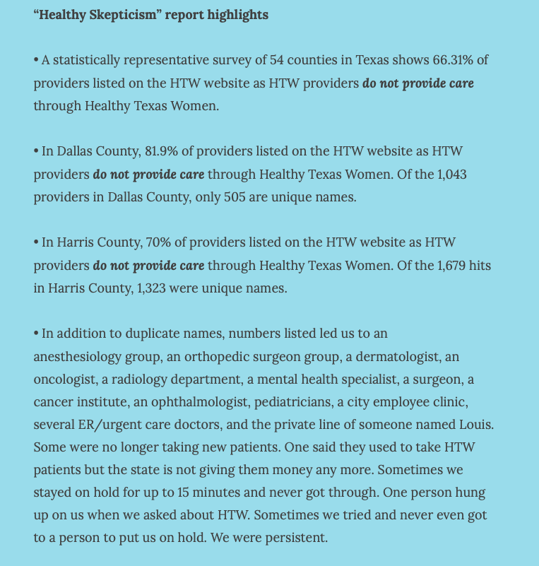

Slide 46
Late-breaking News!
From an email from one EDPW member who had gone to Austin to address the Task Force.
“As we were driving out of Austin on our way home, I got an email from Rep. Victoria Neave’s office ….
Neave was introducing a bill to mandate reviews of the Healthy Texas Women provider list every six months – a direct result of our work!!”

Slide 47
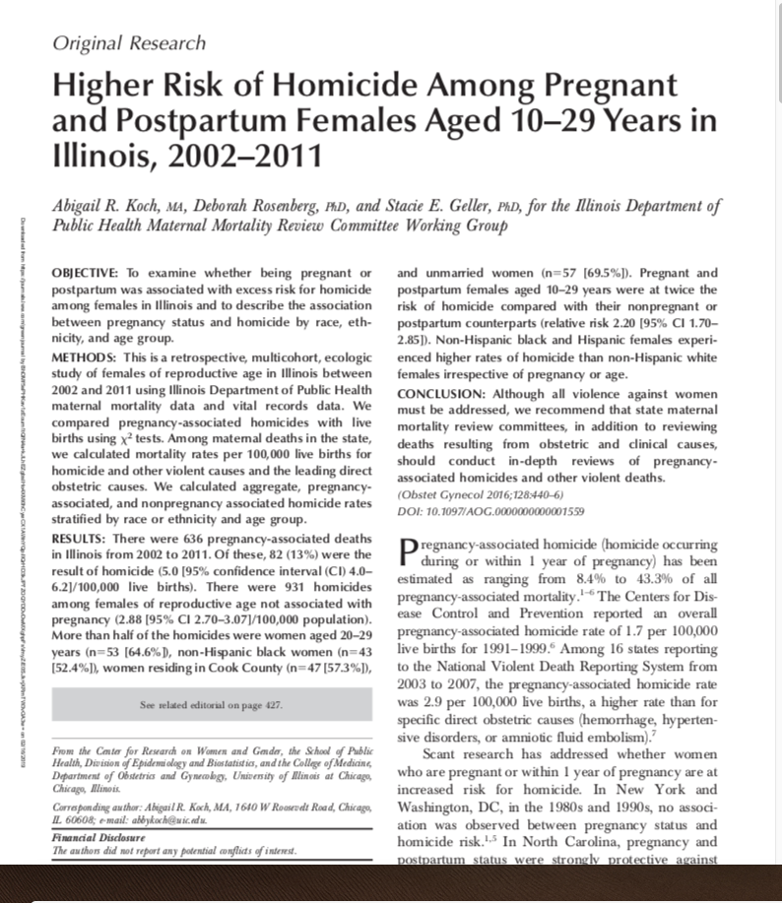
Take Away Points
Pregnancy increases risk for homicide in some women.
Women of color are at highest risk
Maternal mortality review boards should review deaths of pregnancy-associated homicides- The Texas Task Force does not.

Slide 48
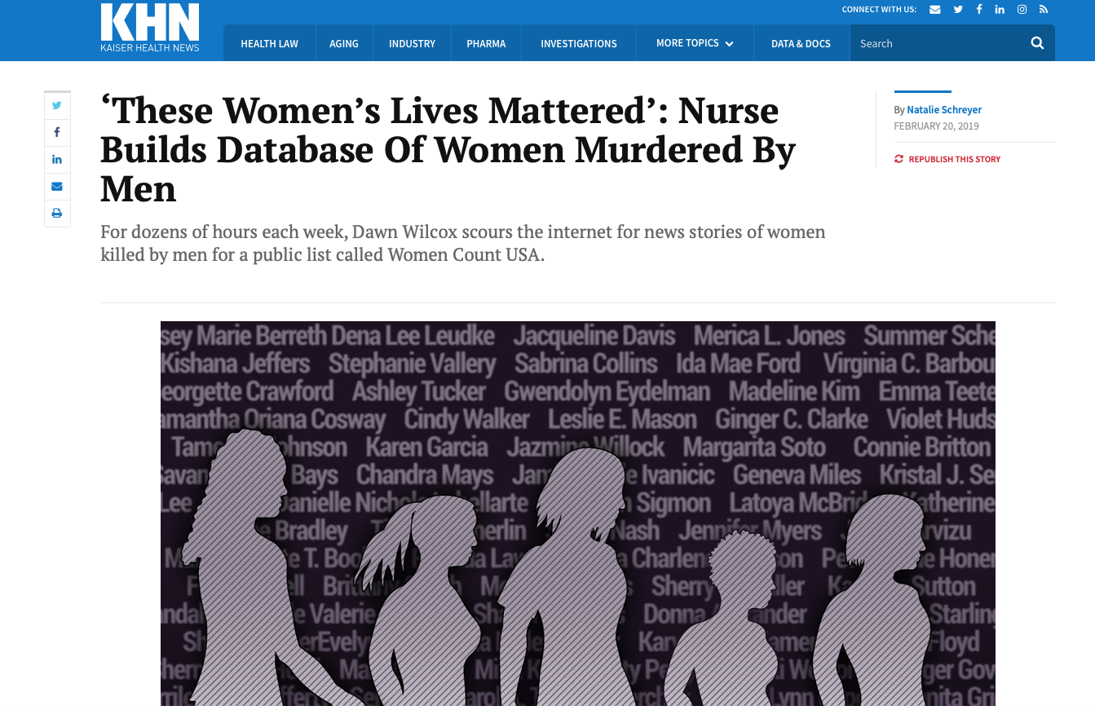

Slide 49
CAUTION:
The next two slides can be very disturbing.
If you have been assaulted or have friends or family who are victims of assault or homicide you may want to step out and come back in 3 minutes.

Slide 50

Dawn is reporting maternal mortality in real time.

Slide 52
Dawn’s efforts make it possible for the first time for our research team to interview the family and friends of each victim because their names are in her database.
We want to discover how health and social services providers, law enforcement, the judicial system, family, friends, and others in her community missed opportunities to save her life.

Slide 53

Recap: We should not leave Maternal Mortality to
Law Makers, Professionals, the
Maternal Morbidity and Mortality Task Force…
Decreasing Maternal Mortality requires linking women at risk for homicide with others in her community to find solutions that work.

Slide 54
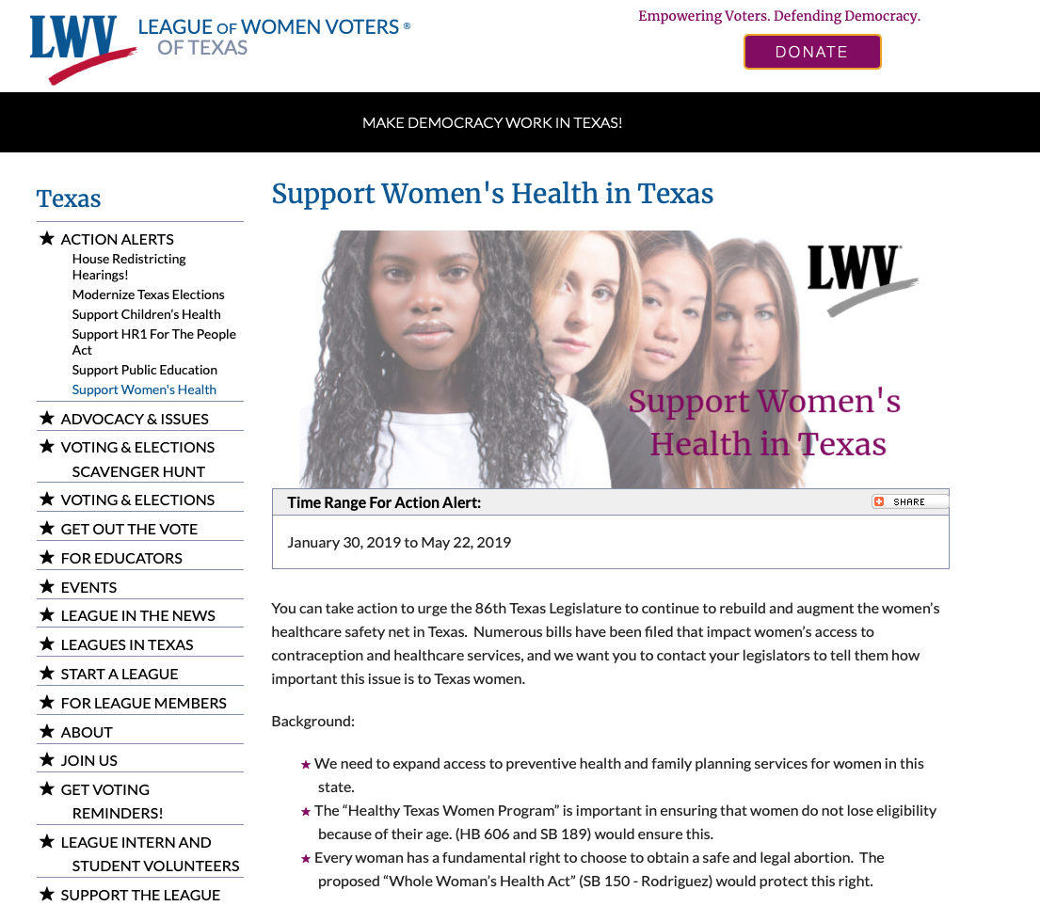

Slide 55


Slide 56
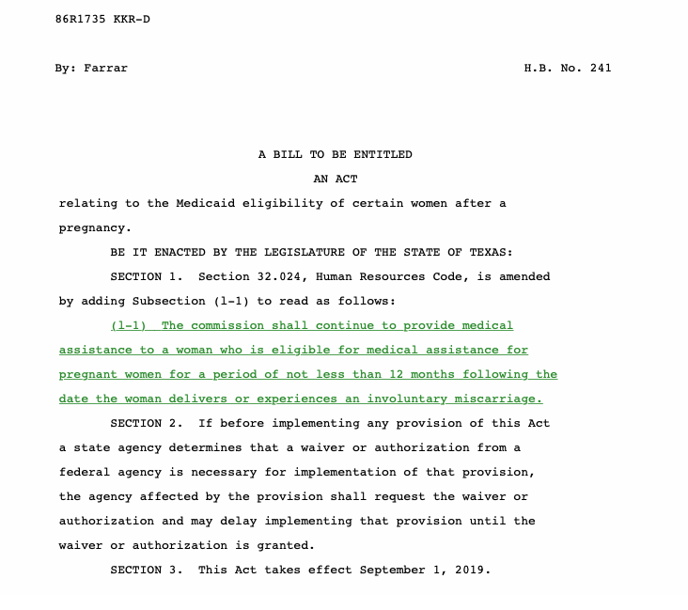
CONTACT LEGISLATORS and VOTE!

Slide 57

STAY INFORMED AND HELP TEXAS REDUCE MATERNAL MORTALITY!

